Slide 1
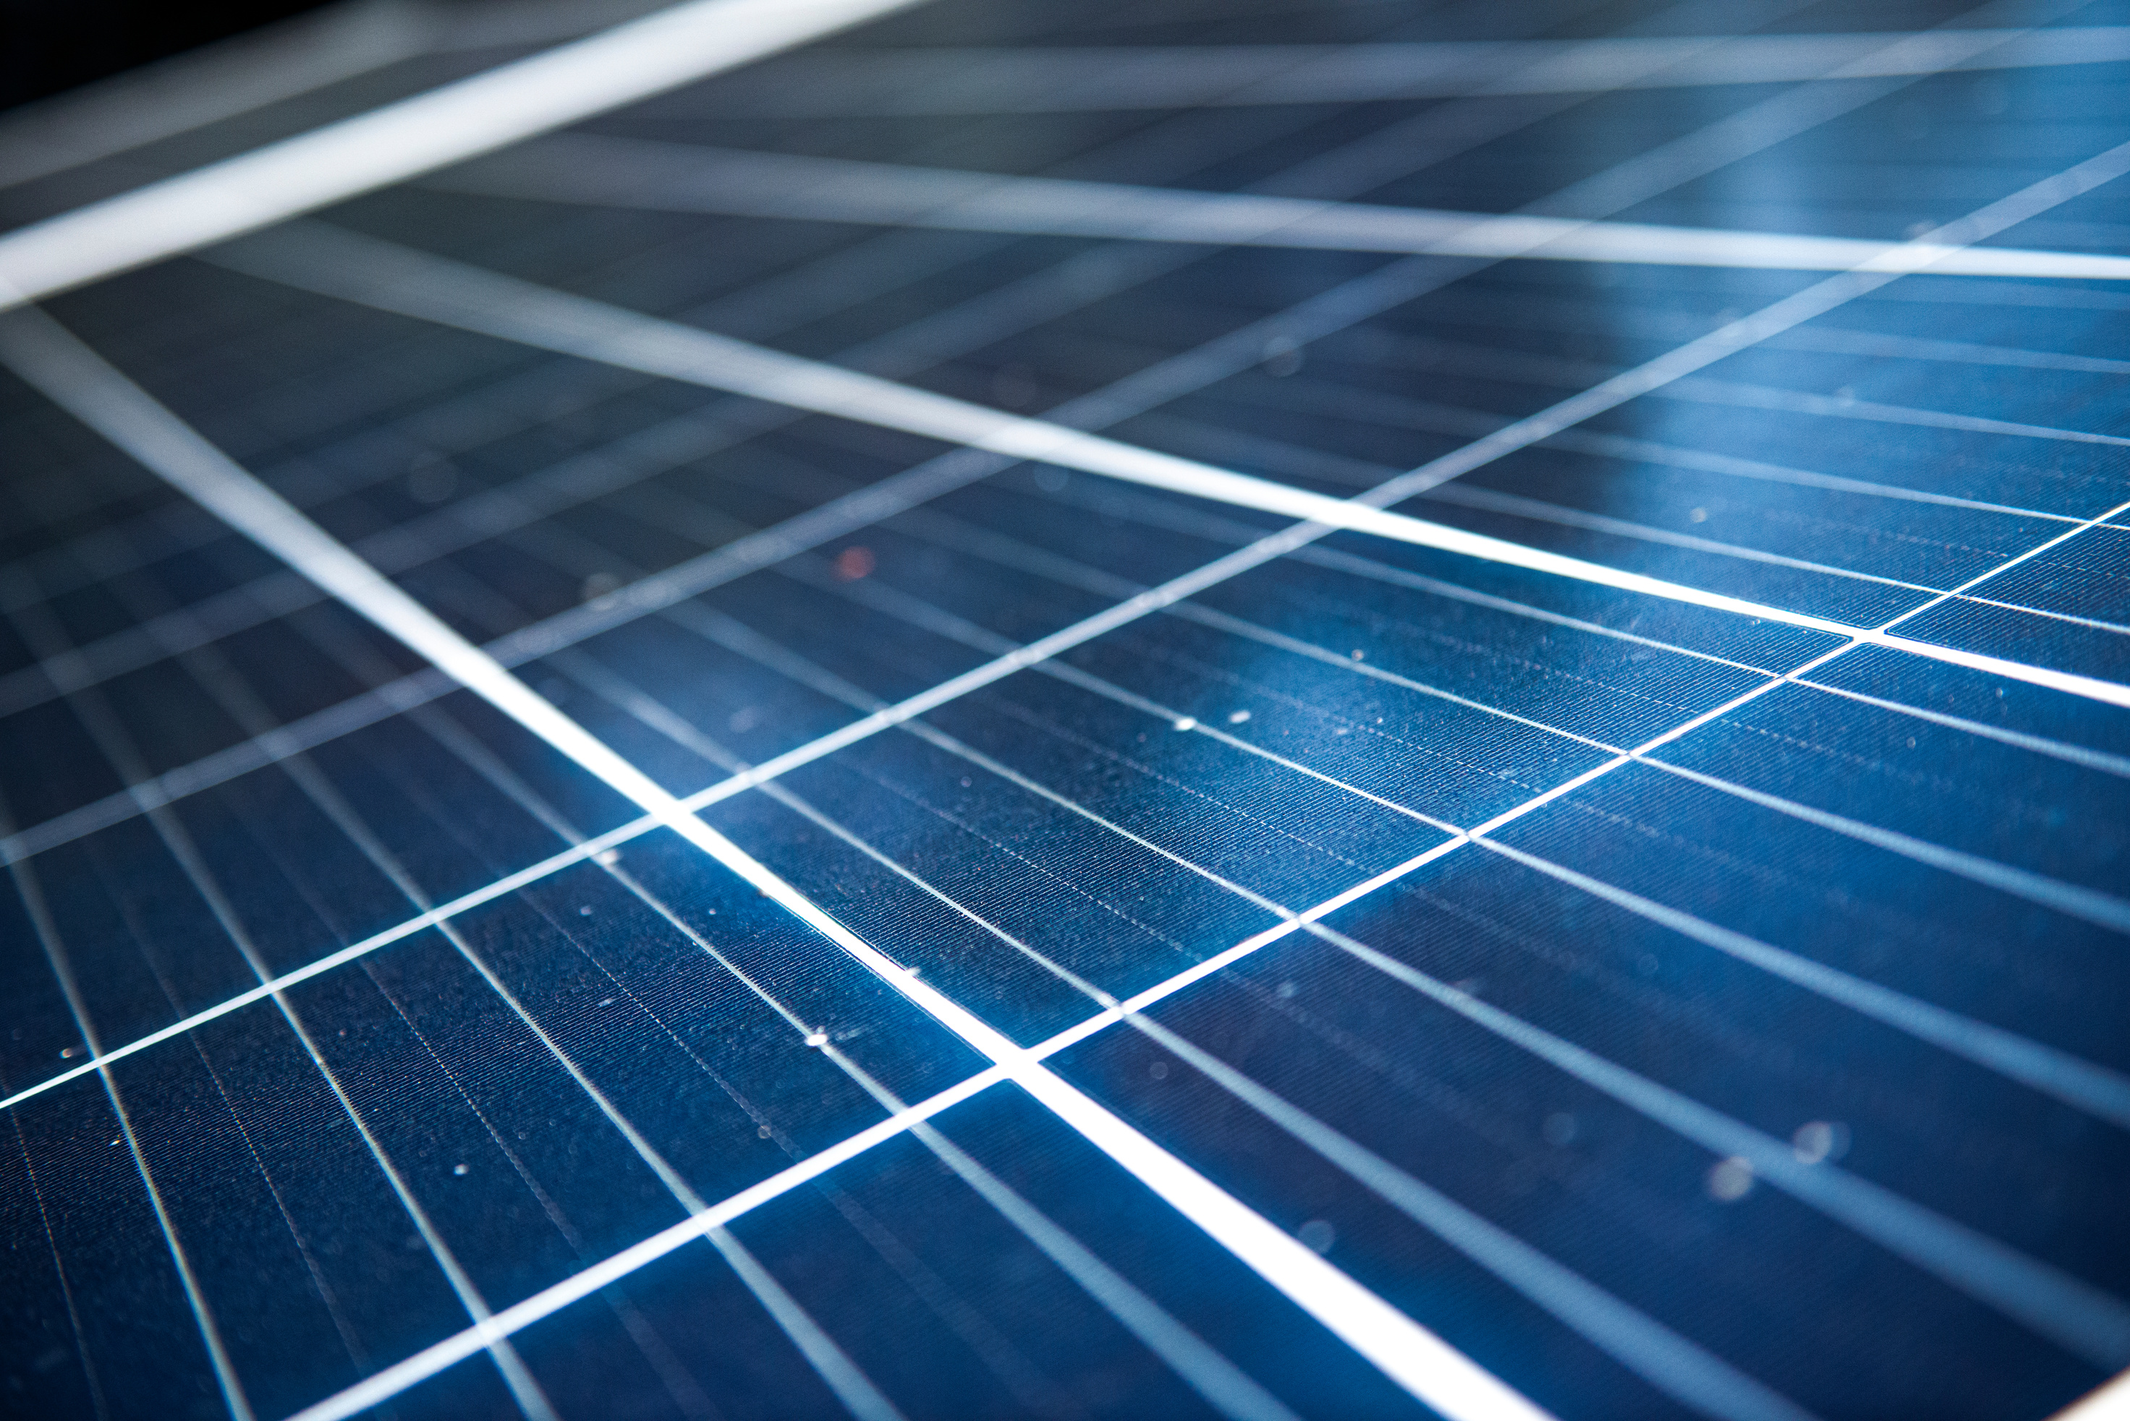

14 JAN 2025
Smart Grid Project
Capacity Planning for Pv and Battery System
Presented by:
Ali Abdollahzadeh , Arezou Shadkam, Kiyana Sabet

Slide 2
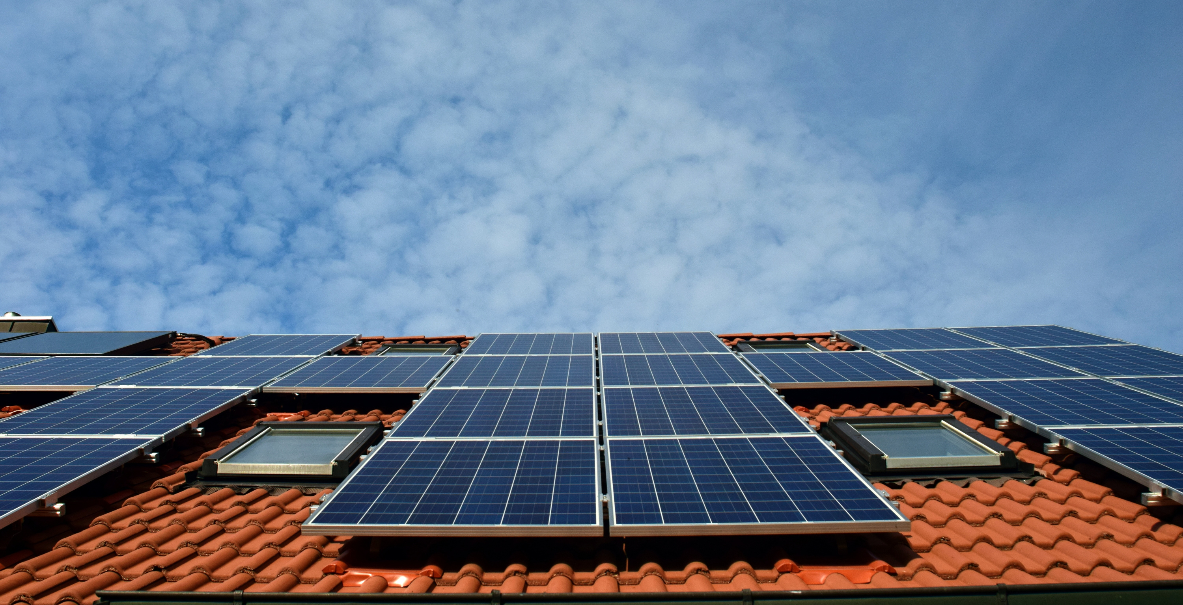
Objective
What we aimed to achieve
We aimed to answer 3 key questions::
How can a household use solar energy to meet its own energy demand?
What is the best size for a solar panel system and battery storage to reduce costs?
How long will it take to recover the investment and start making savings?

Slide 3

Methodology
Steps taken in the project
01.
05.
Data Collection and Cleaning
Optimizing Battery Size
02.
06.
Energy Demand Simulation
Cost Analysis
03.
07.
Surplus and Deficit Calculation
Visualization of Results
04.
08.
Finding the Best Panel Size
Optimizing the System

Slide 4


Our data
Collection and Simulation
PV
04. Energy Demand using Gym AI
We collected data for 2022 from:
To better understand energy usage patterns, we developed a custom Gym environment to simulate hourly energy demand over the course of a year.
The simulation considered appliance usage, heating needs, lighting, and seasonal variations.
01. Electricity Price from GSE
02. Solar Generation from PVGIS
03. Investment Cost from statista

Slide 5
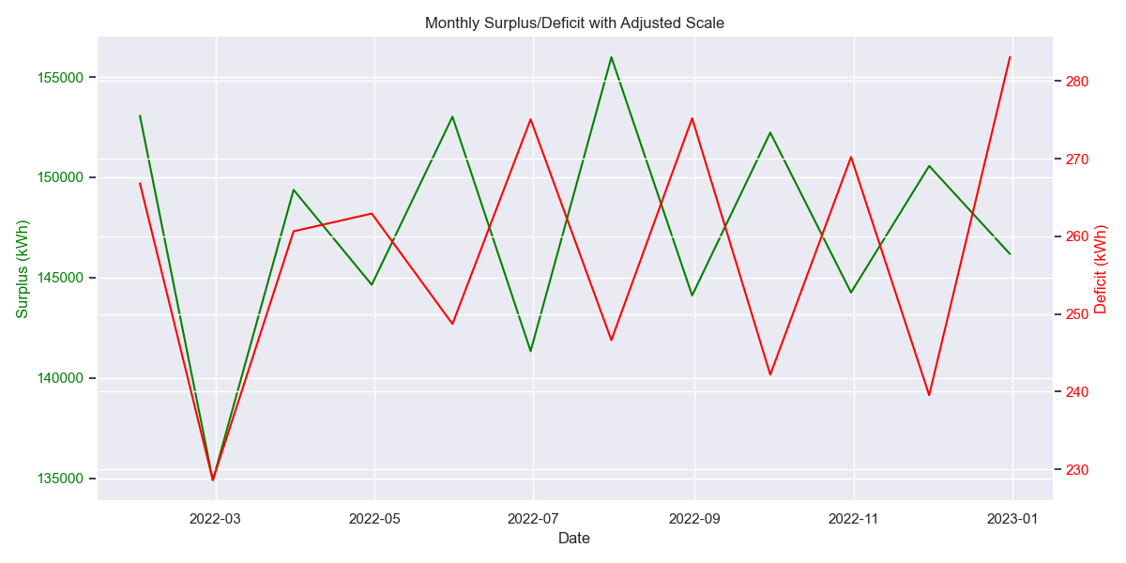
Surplus and Deficit Calculation
We calculated hourly and monthly energy surplus/deficit by comparing:
Solar energy generation (from the PV system).
Household energy demand (from the simulation).

Slide 6
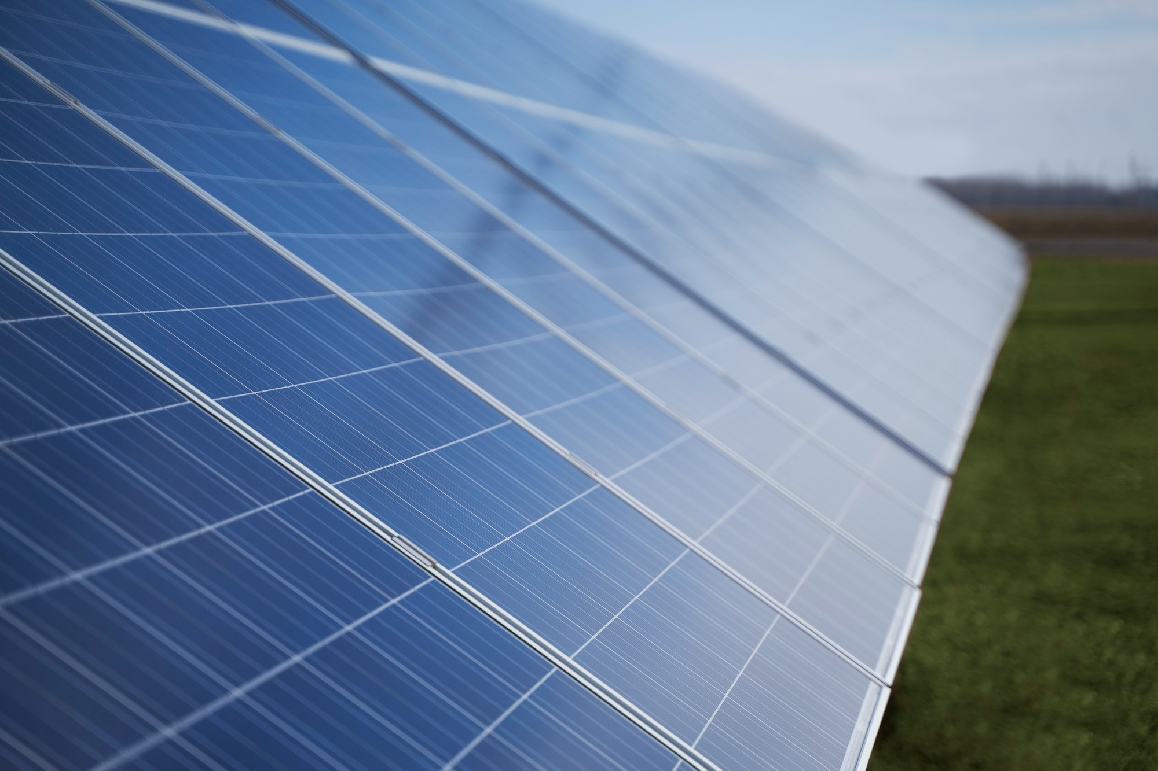
Finding the Best Solar Panel Size
PV Size (kW) | Annual Generation (kWh) | Demand (kWh) | Surplus (kWh)
5 kW | 6,000 | 4,800 | +1,200
10 kW | 12,000 | 4,800 | +7,200
A 10 kW PV system covers the household’s energy needs and generates a reasonable surplus.
Optimal balance:
10-15 kW system provides self-sufficiency and a short payback period.

Slide 7
Optimizing Battery Storage Size
Battery Size (kWh) | Grid Dependency (%) | Investment Cost (EUR)
500 | 45% | 150,000
750 | 30% | 225,000
1,000 | 15% | 300,000
1,500 | 5% | 450,000
A 1,000 kWh battery reduces grid dependency to 15% and ensures energy availability during peak demand.

Slide 8
5 kW + 500 kWh Battery
Total Cost
ROI
210,000 €
25.3%
Cost Analysis
Annual Savings
Payback Period
7,500 €
28
Years
What We Did:
Calculated the total investment cost for different combinations of PV system size and battery storage.
Estimated annual savings from reduced electricity bills and feed-in earnings from selling surplus energy.
Evaluated Payback Period and Return on Investment (ROI) to determine financial feasibility.
10 kW + 750 kWh Battery
Total Cost
ROI
300,000 €
30.0%
Annual Savings
Payback Period
12,000 €
25
Years
15 kW + 1,000 kWh Battery
Total Cost
ROI
Mathematical Model
405,000 €
35.5%
ROI= (annual_savings + feed_in_earnings) / total_investment_cost * 100
Payback Period
Annual Savings
15,800 €
22.3
Years

Slide 9
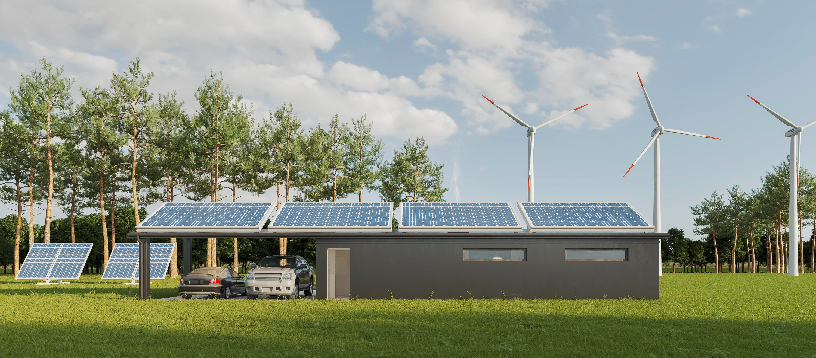
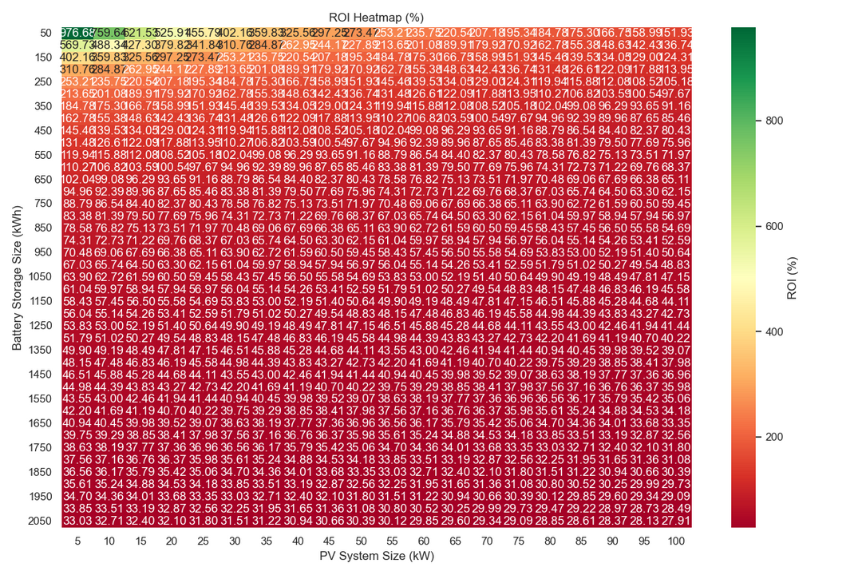
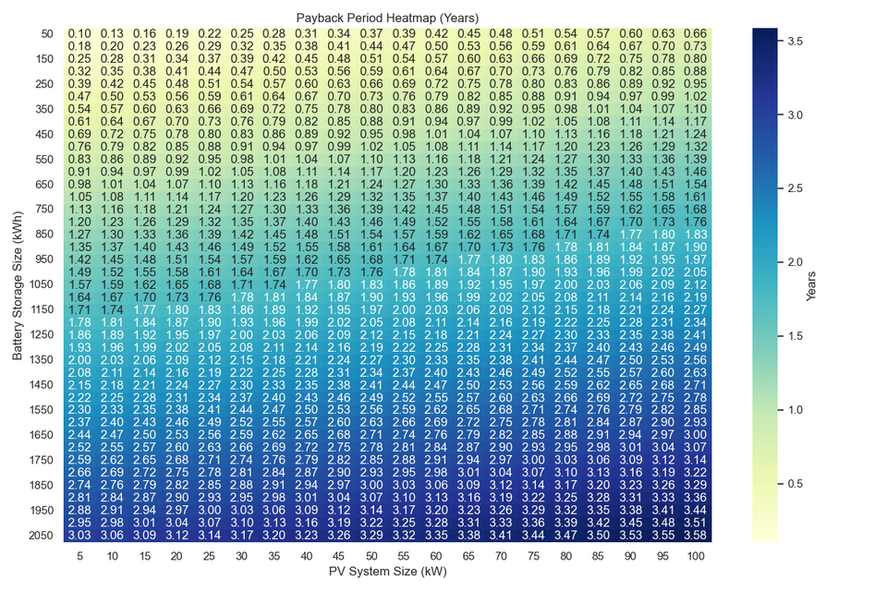
Visualization
Payback Period Heatmap Analysis:
The optimal system configurations (shortest payback periods) tend to be around smaller PV systems (10-30 kW) combined with moderate battery sizes (150-500 kWh).
The Return on Investment (ROI) Heatmap:
the percentage of profit generated relative to the initial investment. The higher the ROI, the more profitable the system:
Green Areas represent configurations with an exceptionally high ROI (above 800%).
Red/Orange Areas show lower ROIs, indicating less profitable configurations.

Slide 10
Optimizing the System
PV Size (kW) | Battery Size (kWh) | Payback Period (Years) | ROI (%)
10 | 750 | 22.5 | 35.2
15 | 1,000 | 20.8 | 38.5
20 | 1,500 | 19.3 | 40.1
Key Insights:
The optimal combination is a 10-15 kW PV system with a 750-1,000 kWh battery.
This configuration offers:
A short payback period (20-23 years).
High ROI (~35-40%).
Significant grid dependency reduction.
Larger systems have higher costs but can generate more surplus energy for additional earnings.

